Slide 1
Status of the SpinQuest experiment and proposal of the DarkQuest upgrade
Nhan Tran on behalf of the SpinQuest and DarkQuest communities
June 2022 FNAL PAC meeting
June 23, 2022

Slide 2
Outline
SpinQuest and the DarkQuest upgrade
Dark sector searches at SpinQuest and DarkQuest + Snowmass framing + Recent progress
SpinQuest status and future nuclear/spin physics program
Collaboration and Outlook
Charge: We ask the PAC to review the status of the SpinQuest experiment and the proposal for its upgrade, referred to as DarkQuest.

Slide 3
SpinQuest and the DarkQuest upgrade
SeaQuest (e906) - dimuon spectrometer
SpinQuest (e1039) - dimuon spectrometer + polarized target
DarkQuest - EMCal/tracking/target upgrade to dimuon spectrometer
Notes:
See talk from Alexey too!

Slide 4
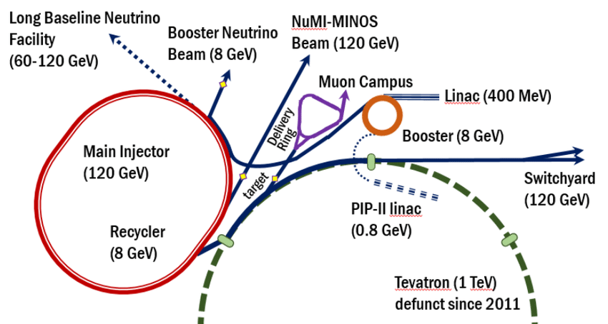
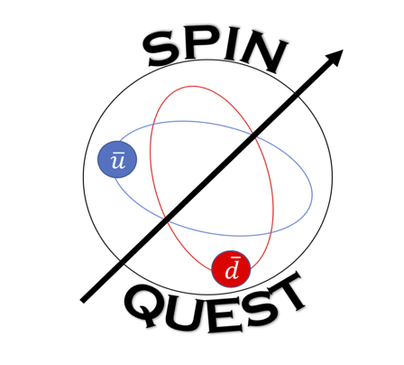
SpinQuest and DarkQuest
NM4 experimental hall

Slide 5
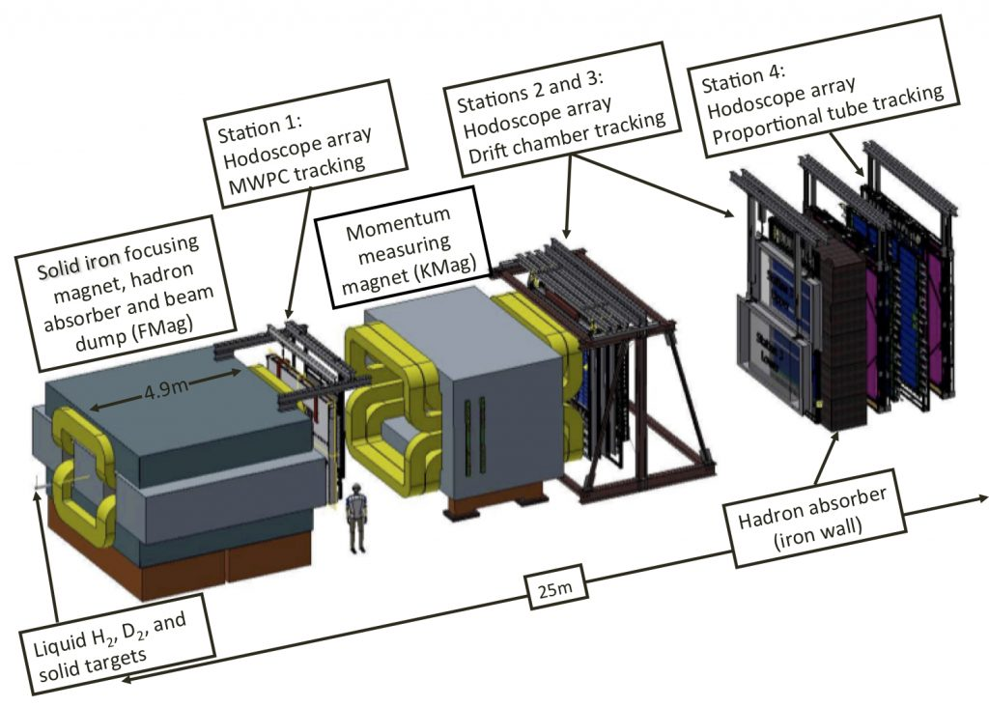
SpinQuest
μ
μ
Proton beam
E1039 (2022+): Polarized NH3 target

Slide 6
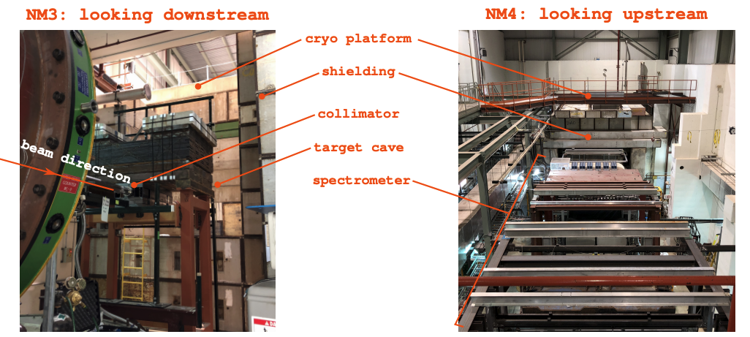
SpinQuest

Slide 7
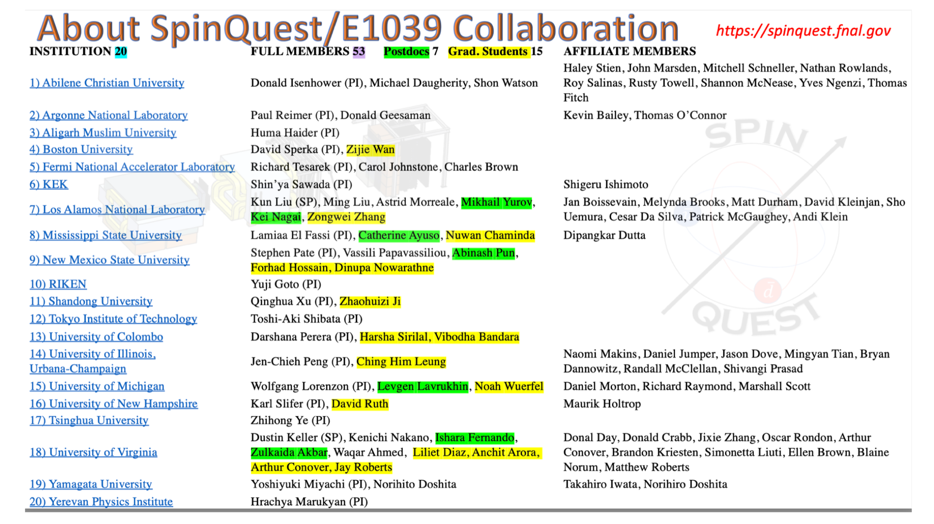
SpinQuest collaboration

Slide 8
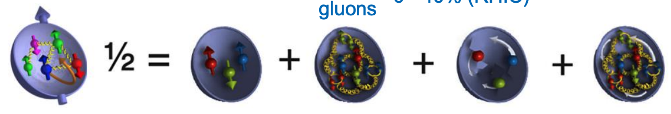
SpinQuest - proton spin puzzle
Puzzle: EMC experiment (1987) measured only ~25% of proton spin comes from valence quarks (unexpected!)
Other potential contributions: Orbital angular momentum (OAM) of the quarks and gluons
[Lattice QCD predicts non-zero quark OAM]
valence quark spin
(~25%, SLAC/CERN)
gluon spin
(0-40%, RHIC)
(sea) quark + gluon orbital angular momentum (OAM) ??

Slide 9
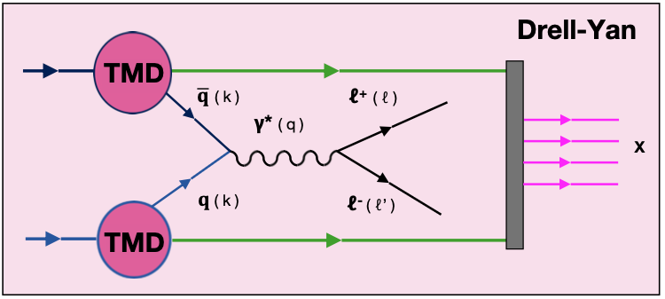
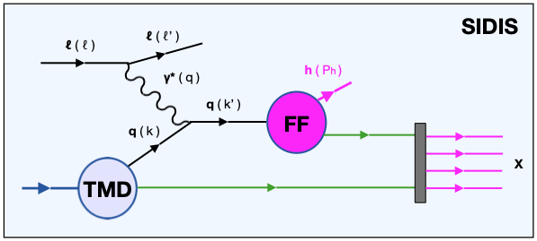
SpinQuest - proton spin puzzle
Puzzle: EMC experiment (1987) measured only ~25% of proton spin comes from valence quarks (unexpected!)
Other potential contributions: Orbital angular momentum (OAM) of the quarks and gluons
[Lattice QCD predicts non-zero quark OAM]
valence quark spin
(~25%, SLAC/CERN)
gluon spin
(0-40%, RHIC)
(sea) quark + gluon orbital angular momentum (OAM) ??
Drell-Yan is a critical complement to SIDIS (semi-inclusive deep inelastic scattering) for measuring the proton spin and testing QCD, both are required
Cleanest method with no fragmentation function, two parton TMDs, direct access to sea-quark distributions

Slide 10
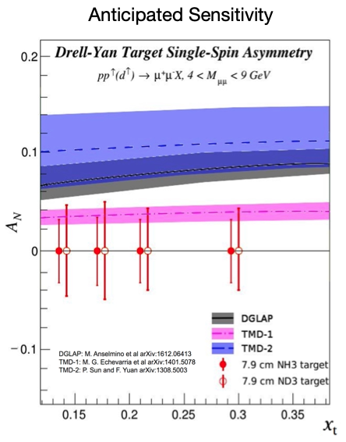

SpinQuest - proton spin puzzle
Puzzle: EMC experiment (1987) measured only ~25% of proton spin comes from valence quarks (unexpected!)
Other potential contributions: Orbital angular momentum (OAM) of the quarks and gluons
[Lattice QCD predicts non-zero quark OAM]
valence quark spin
(~25%, SLAC/CERN)
gluon spin
(0-40%, RHIC)
(sea) quark + gluon orbital angular momentum (OAM) ??
Measuring non-zero Sivers asymmetry at SpinQuest requires sea-quark OAM - observation would be a major discovery!

Slide 11
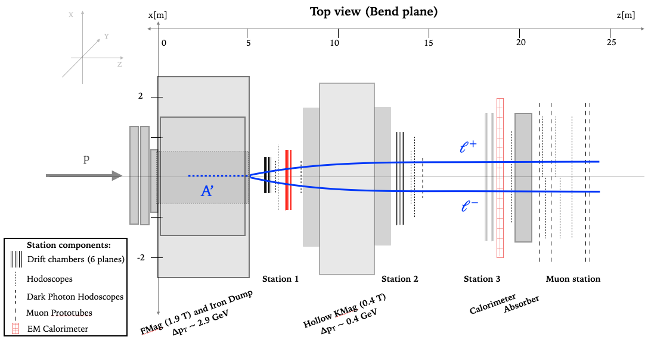
SpinQuest and DarkQuest upgrade
Dark sector signature
SpinQuest: muon final states
DarkQuest: e,γ,π,...
System upgrades
Existing EMCal from PHENIX
Tracking MWPC available
Tensor polarized deuteron target

Slide 12
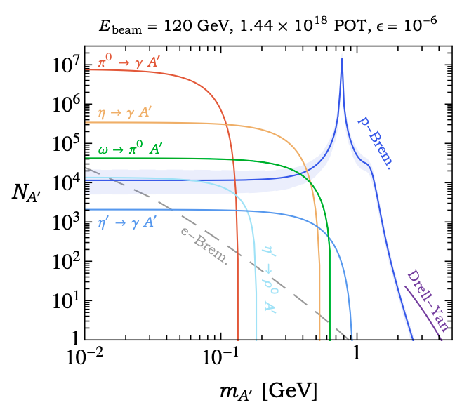
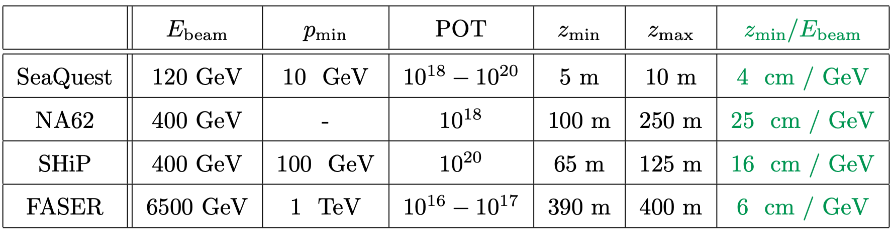
Unique features of SpinQuest/DarkQuest for dark sectors
Berlin, Gori, Schuster, Toro
https://arxiv.org/abs/1804.00661
Large putative dark sector production cross section with 120 GeV proton beam
5m beam dump - geometry sensitive to unique lifetime baseline
Spectrometer with KMAG provides good momentum measurement for forward decays
EMCal opens up new final states distinct from large muon backgrounds
Existing experiment and infrastructure means we require modest investment - short time to high impact physics!

Slide 13
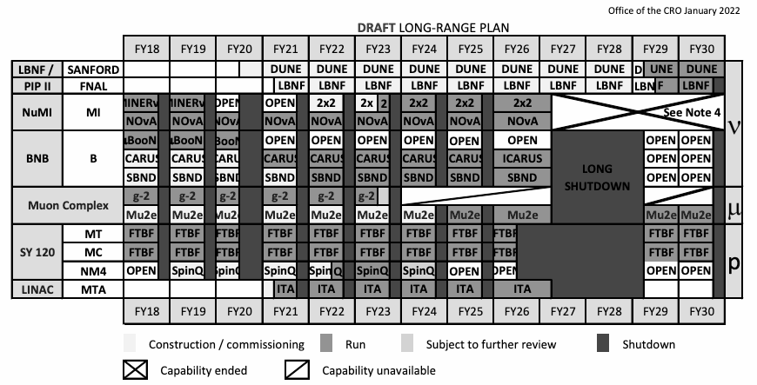
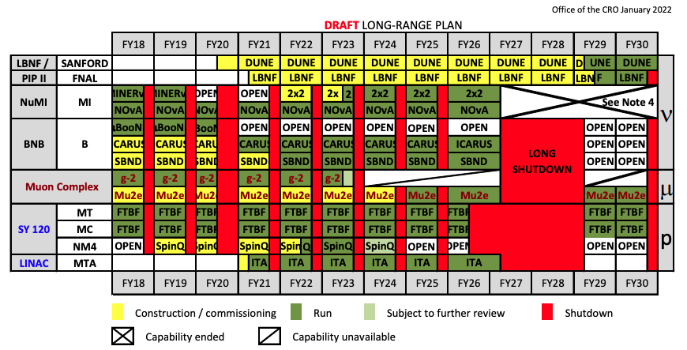
Timelines
Near-term window of opportunity, including FY25-26
Notes:
aggressive plan - pre-work starting and to be done

Slide 14
High level vision – SpinQuest and DarkQuest
A vibrant and powerful spin and dark sector program running together
SpinQuest Phase
proton spin puzzle - measure Sivers asymmetry
dark sectors in muon final states
DarkQuest Phase
EMCal upgrade (no degradation of spin physics), enhanced tracking and targetry
expanded spin physics program measuring transversity
expanded dark sector program in e,γ,π final states
High impact HEP dark sectors and NP/spin physics; strong complementarity with Fermilab capabilities and timelines for modest resources

Slide 15
Dark sector searches at SpinQuest and DarkQuest
Snowmass framing (also, see PAC talk from Alexey Petrov on Rare and Precision Frontier) Recent progress from the SpinQuest dark sector community

Slide 16
Physics drivers
Dark matter exists
Thermal freeze-out DM narrows the mass range to ~MeV-TeV
Provides clear milestones
No discovery in WIMP searches thus far
Dark sectors can solve many experimental/theoretical puzzles
Dark sectors mean SM-neutral forces (typically < ~GeV)
Can include dark matter
Visible (SM) final states important to explore for discovery

Slide 17
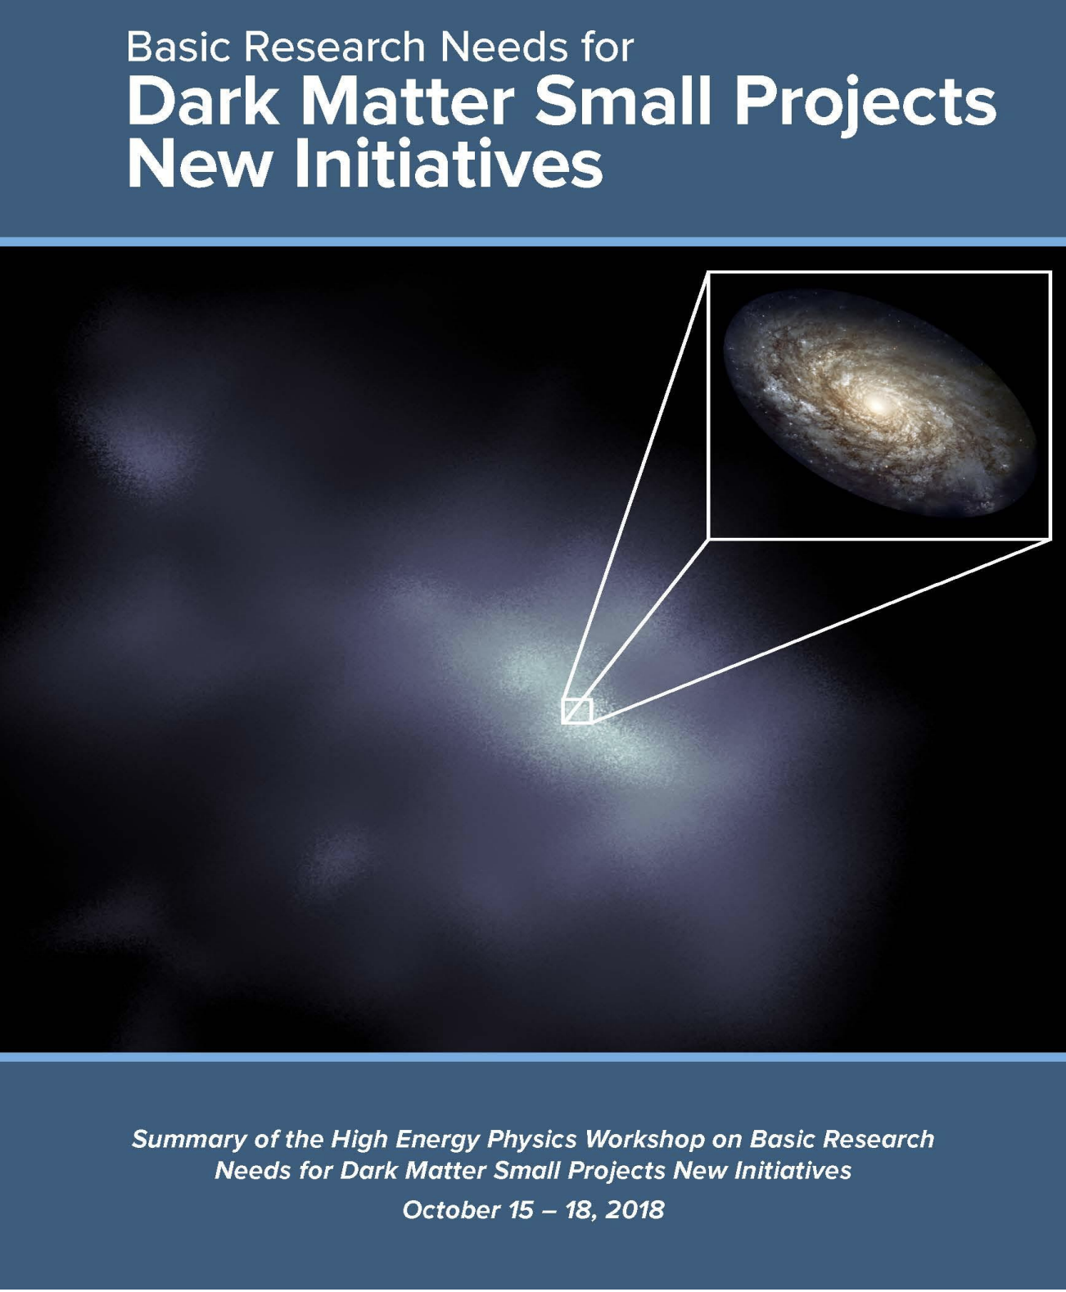
Setting the stage: dark sectors at accelerators
Dark Matter New Initiatives report
Notes:
Can we move Strong CP to red (non-thermal)
Fix Relaxion (spelled wrong)
Mention BRN - Thrust 2 is perfect fit for DarkQuest

Slide 18
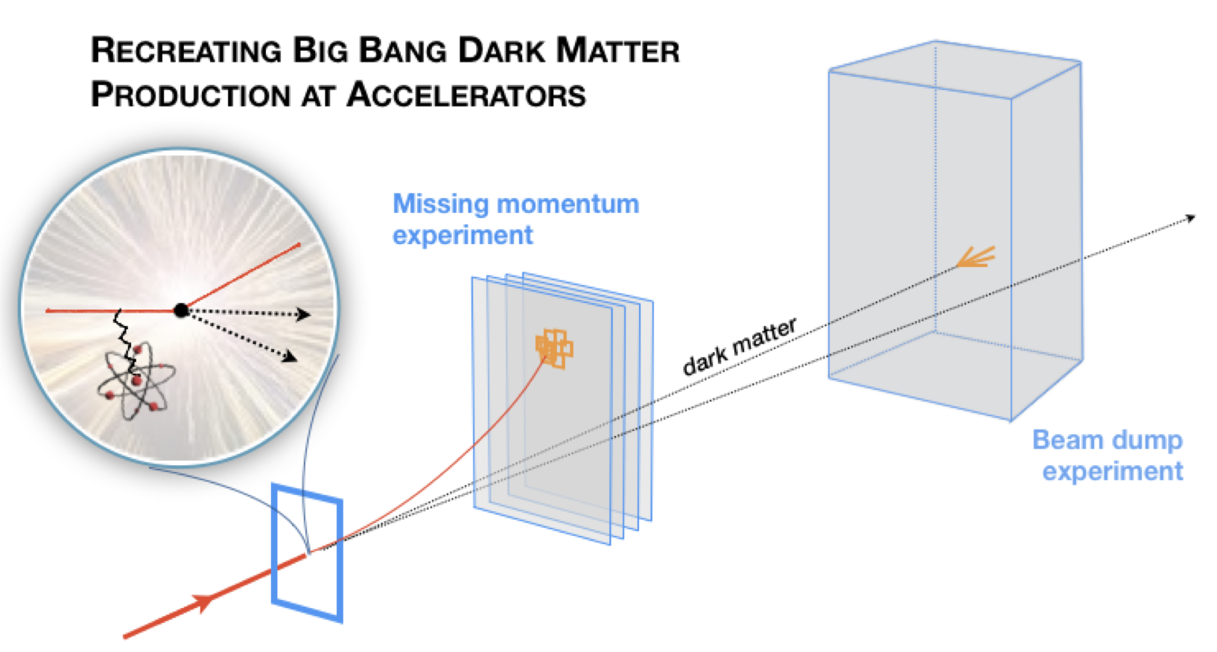
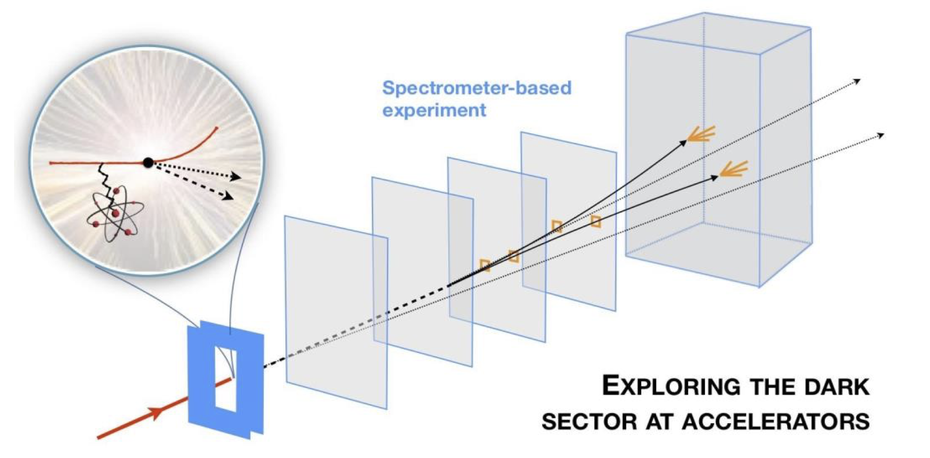
Setting the stage: dark sectors at accelerators
Dark Matter New Initiatives report
Thrust 1: target thermal dark matter milestones
Thrust 2: Exploration structure of dark sectors
Notes:
Can we move Strong CP to red (non-thermal)
Fix Relaxion (spelled wrong)
Mention BRN - Thrust 2 is perfect fit for DarkQuest

Slide 19
Snowmass RF6 Big Ideas
RF6 report (to appear)
Strong connection with NF03, EF10, AF5, CF6
Dark matter production at intensity frontier experiments
Benchmarks:
dark photon,
scalar, neutrino portal, millicharged
Exploring dark sector portals with high intensity experiments
Benchmarks:
dark photon,
scalar, neutrino portal, axion-like particle (ALPs)
New flavors and rich structures in dark sectors
Benchmarks:
g-2, SIMPs,
inelastic DM,
non-minimal ALPs
Notes:
Spend less time on this!

Slide 20
Snowmass RF6 Big Ideas
RF6 report (to appear)
Strong connection with NF03, EF10, AF5, CF6
Dark matter production at intensity frontier experiments
Benchmarks:
dark photon,
scalar, neutrino portal, millicharged
Exploring dark sector portals with high intensity experiments
Benchmarks:
dark photon,
scalar, neutrino portal, axion-like particle (ALPs)
New flavors and rich structures in dark sectors
Benchmarks:
g-2, SIMPs,
inelastic DM,
non-minimal ALPs
SpinQuest/DarkQuest plays a key role
Notes:
Spend less time on this!

Slide 21
Snowmass RF6 Big Ideas
RF6 report (to appear)
Strong connection with NF03, EF10, AF5, CF6
S. Gori, M. Williams
Dark matter production at intensity frontier experiments
Benchmarks:
dark photon,
scalar, neutrino portal, millicharged
Exploring dark sector portals with high intensity experiments
Benchmarks:
dark photon,
scalar, neutrino portal, axion-like particle (ALPs)
New flavors and rich structures in dark sectors
Benchmarks:
g-2, SIMPs,
inelastic DM,
non-minimal ALPs
G. Krnjaic, N. Toro
B. Batell, C. Hearty
P. Harris, P. Schuster, J. Zupan
+ Experiments & Facilities
(P. Ilten, N. Tran)
SpinQuest/DarkQuest plays a key role
Notes:
Spend less time on this!

Slide 22
Snowmass RF6 Big Ideas
RF6 report (to appear)
Strong connection with NF03, EF10, AF5, CF6
S. Gori, M. Williams
Dark matter production at intensity frontier experiments
Benchmarks:
dark photon,
scalar, neutrino portal, millicharged
Exploring dark sector portals with high intensity experiments
Benchmarks:
dark photon,
scalar, neutrino portal, axion-like particle (ALPs)
New flavors and rich structures in dark sectors
Benchmarks:
g-2, SIMPs,
inelastic DM,
non-minimal ALPs
high level frontier benchmarks
G. Krnjaic, N. Toro
B. Batell, C. Hearty
P. Harris, P. Schuster, J. Zupan
+ Experiments & Facilities
(P. Ilten, N. Tran)
SpinQuest/DarkQuest plays a key role

Slide 23
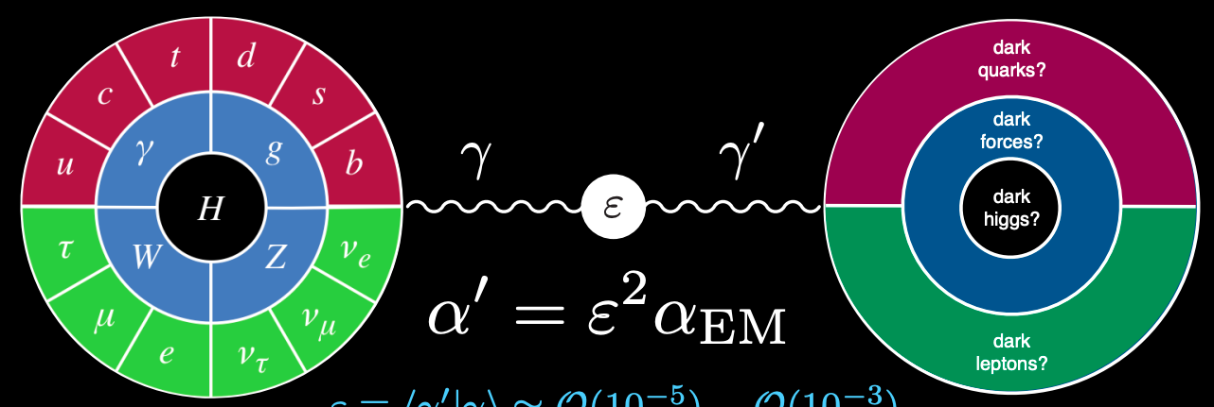
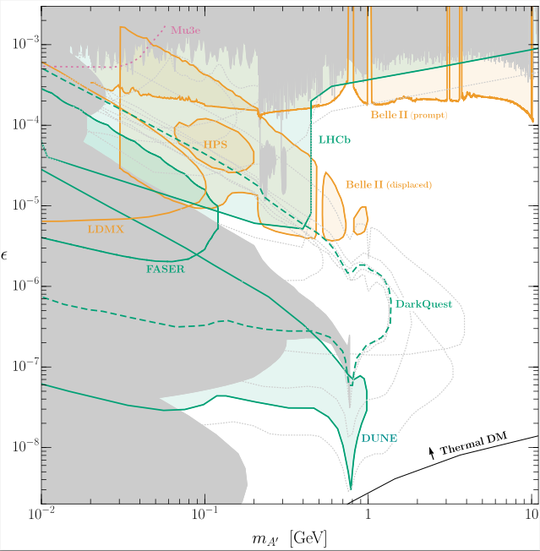
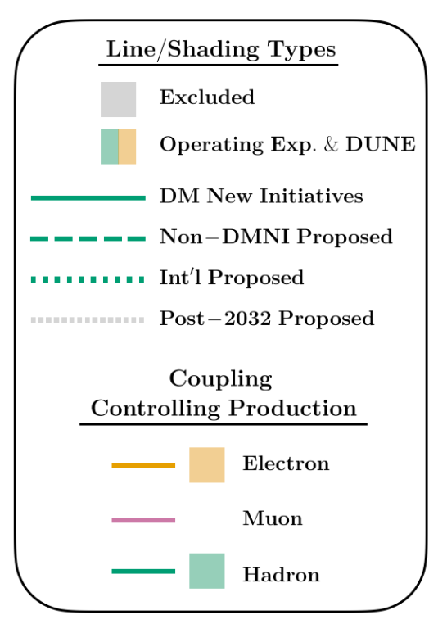
Dark photon benchmark scenario
Snowmass
Preliminary

Slide 24
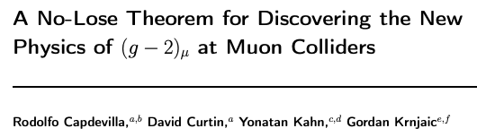
muon g-2 benchmark scenario
(Paraphrasing 2101.10334…)
Step 1. Confirm g-2 anomaly
Step 2. Look for low-scale phenomenon < ~GeV at existing and new facilities
Step 3-5. Build successively higher energy muon colliders

Slide 25
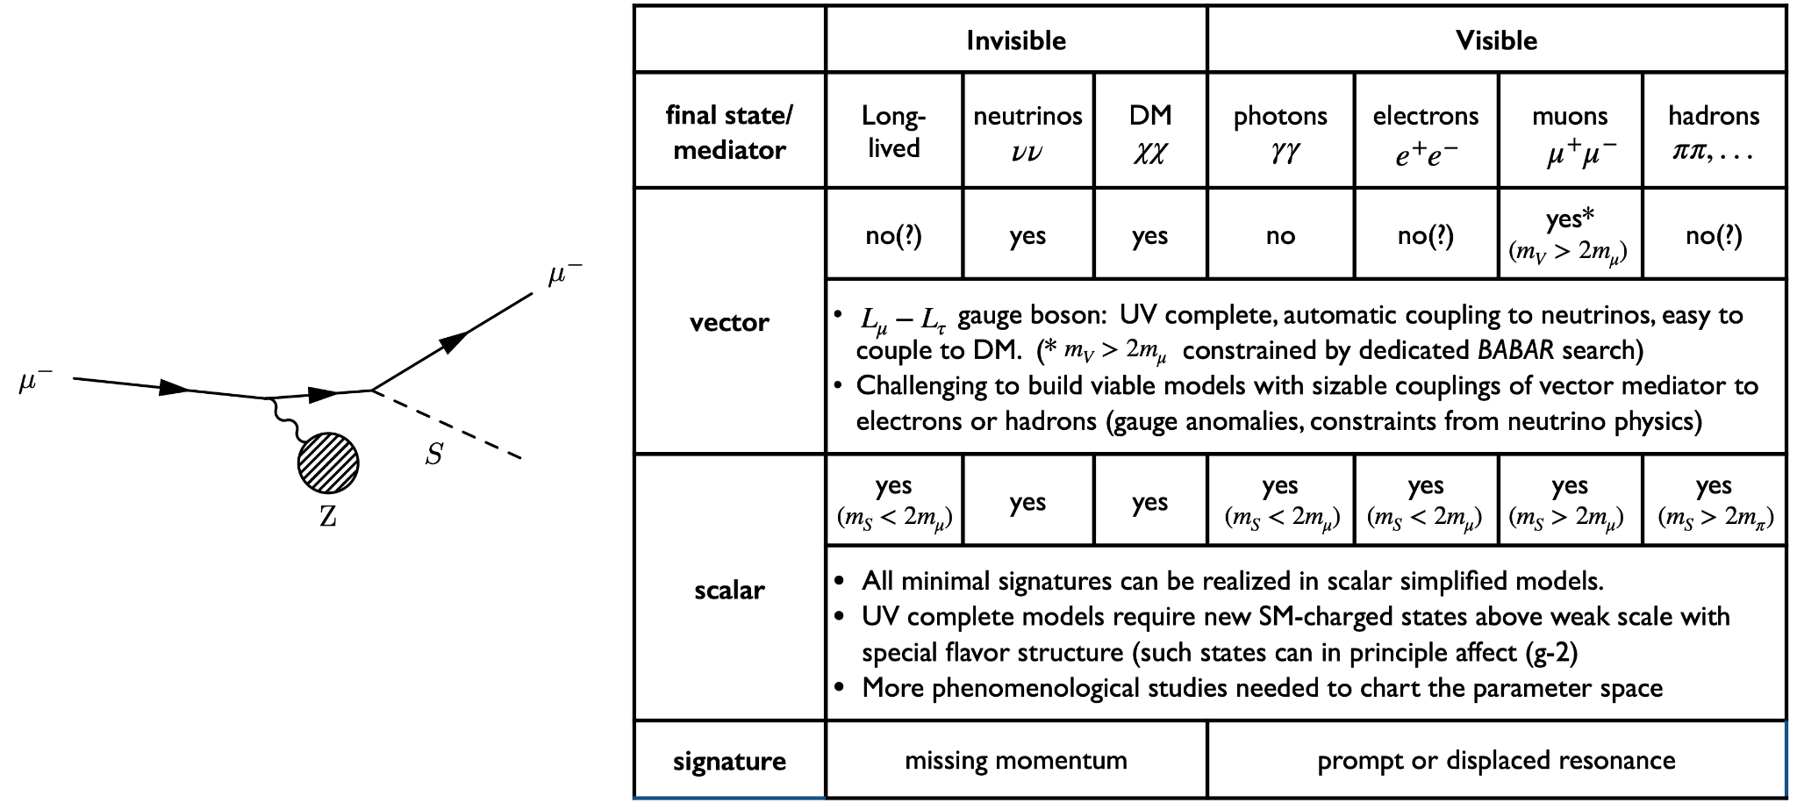
muon g-2 benchmark scenario
B. Batell
(Paraphrasing 2101.10334…)
Step 1. Confirm g-2 anomaly
Step 2. Look for low-scale phenomenon < ~GeV at existing and new facilities
Step 3-5. Build successively higher energy muon colliders

Slide 26
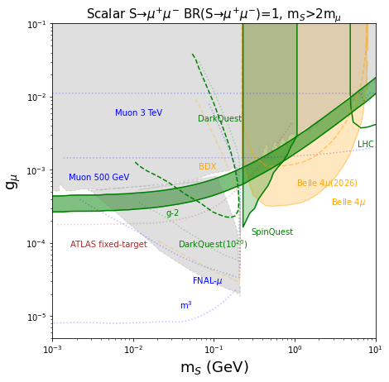
muon g-2 benchmark scenario
Forbes, Kahn, Krnjaic, et al (to appear)
Snowmass
Preliminary
SpinQuest/DarkQuest plays a key role in new physics models for g-2 < ~GeV
SpinQuest limits from FY23 data!
e.g. Belle II limits on full 30ab⁻¹ (> 2030)
DarkQuest limits in ee,γγ channel below 2m_{μ}

Slide 27
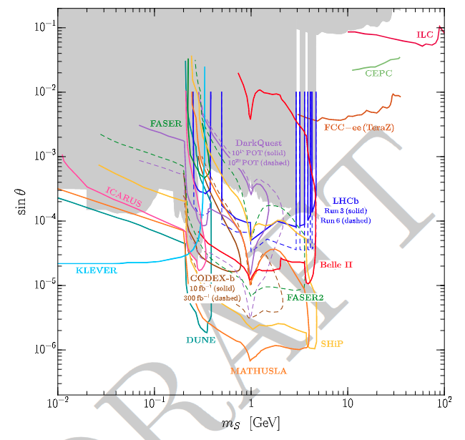
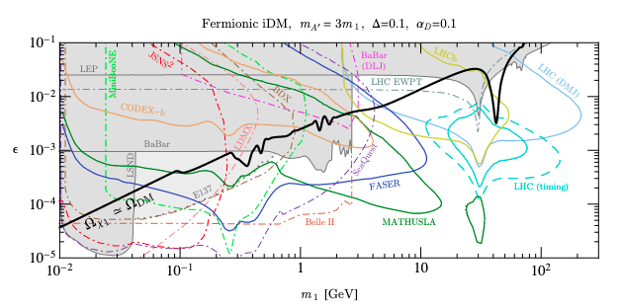
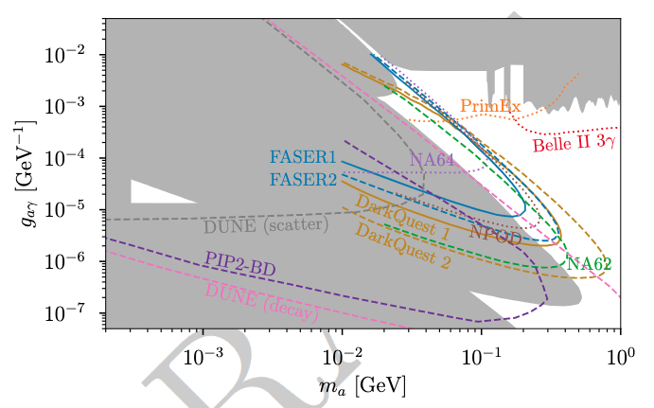
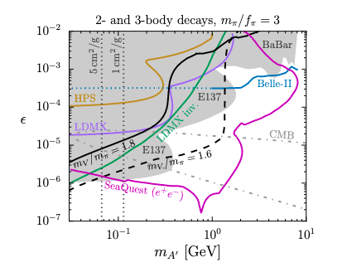
Sensitivity to other Snowmass benchmark scenarios
RF6 reports (to appear)
Berlin, Gori, Schuster, Toro: 1804.00661
Batell, Evans, Gori, Rai: 2008.08108
Blinov, kowalczyk, Wynne: 2112.09814
Higgs-mixed Scalar
Inelastic Dark Matter
(DM candidate with testable targets)
Axion-like Particles
Strongly-Interacting Massive Particles
(DM candidate with testable targets)

Slide 28
Dark sectors at SpinQuest and DarkQuest
SpinQuest (now!)
Cover open g-2 phase space, prompt S/V → μμ
Initial long-lived dark photon (μμ) searches, commission displaced tracking
DarkQuest (soon!)
Large increase in sensitivity to dark photon phase space
Cover open g-2 phase space, displaced S/V → ee,γγ
Enable searches for inelastic DM, SIMPs, ALPs, etc.

Slide 29
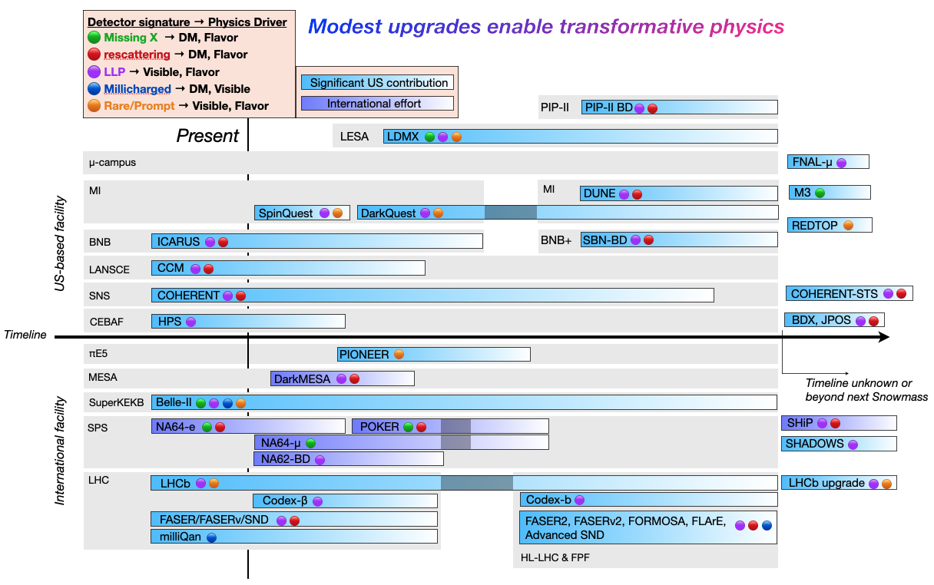
Snowmass
Preliminary
RF6 report
Ilten, Tran, et al
2206.04220
Notes:
add why there are shutdowns

Slide 30
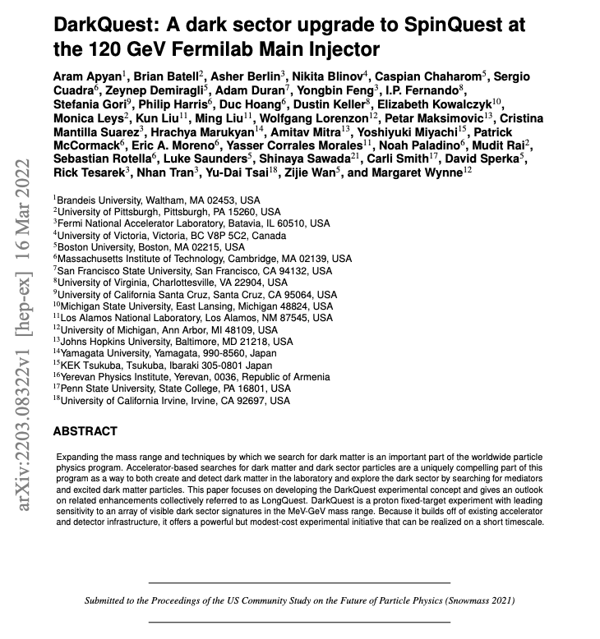


Dark Sectors @ SpinQuest/DarkQuest effort
Theory and experimental community come together over past 2 years - building physics case, detailed full simulation, coordinate with NP community
Notes:
Say there will be an update with electron acceptance and mass resolution?
=> We should add these

Slide 31
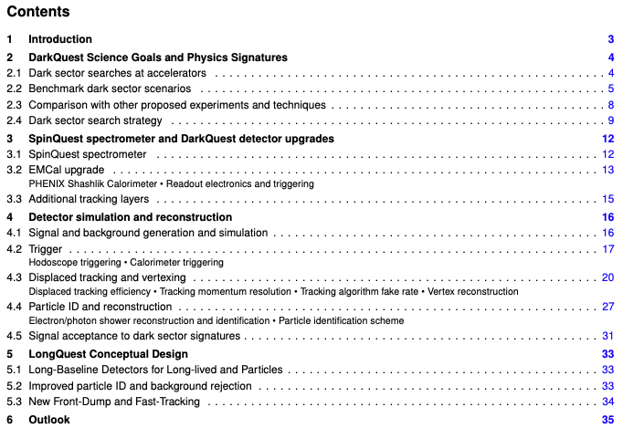
Dark Sectors @ SpinQuest/DarkQuest effort
Theory and experimental community come together over past 2 years - building physics case, detailed full simulation, coordinate with NP community
Notes:
Mention potential of LongQuest for an extended DS program

Slide 32
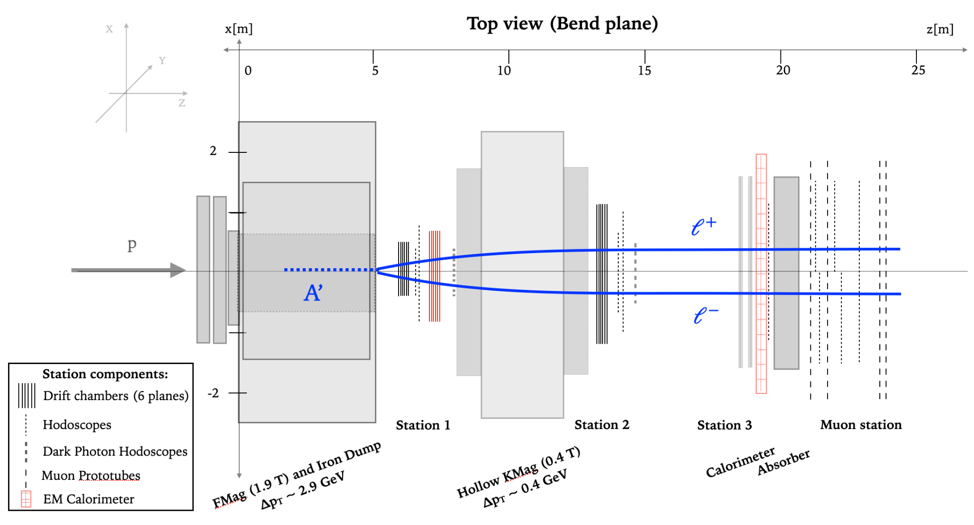
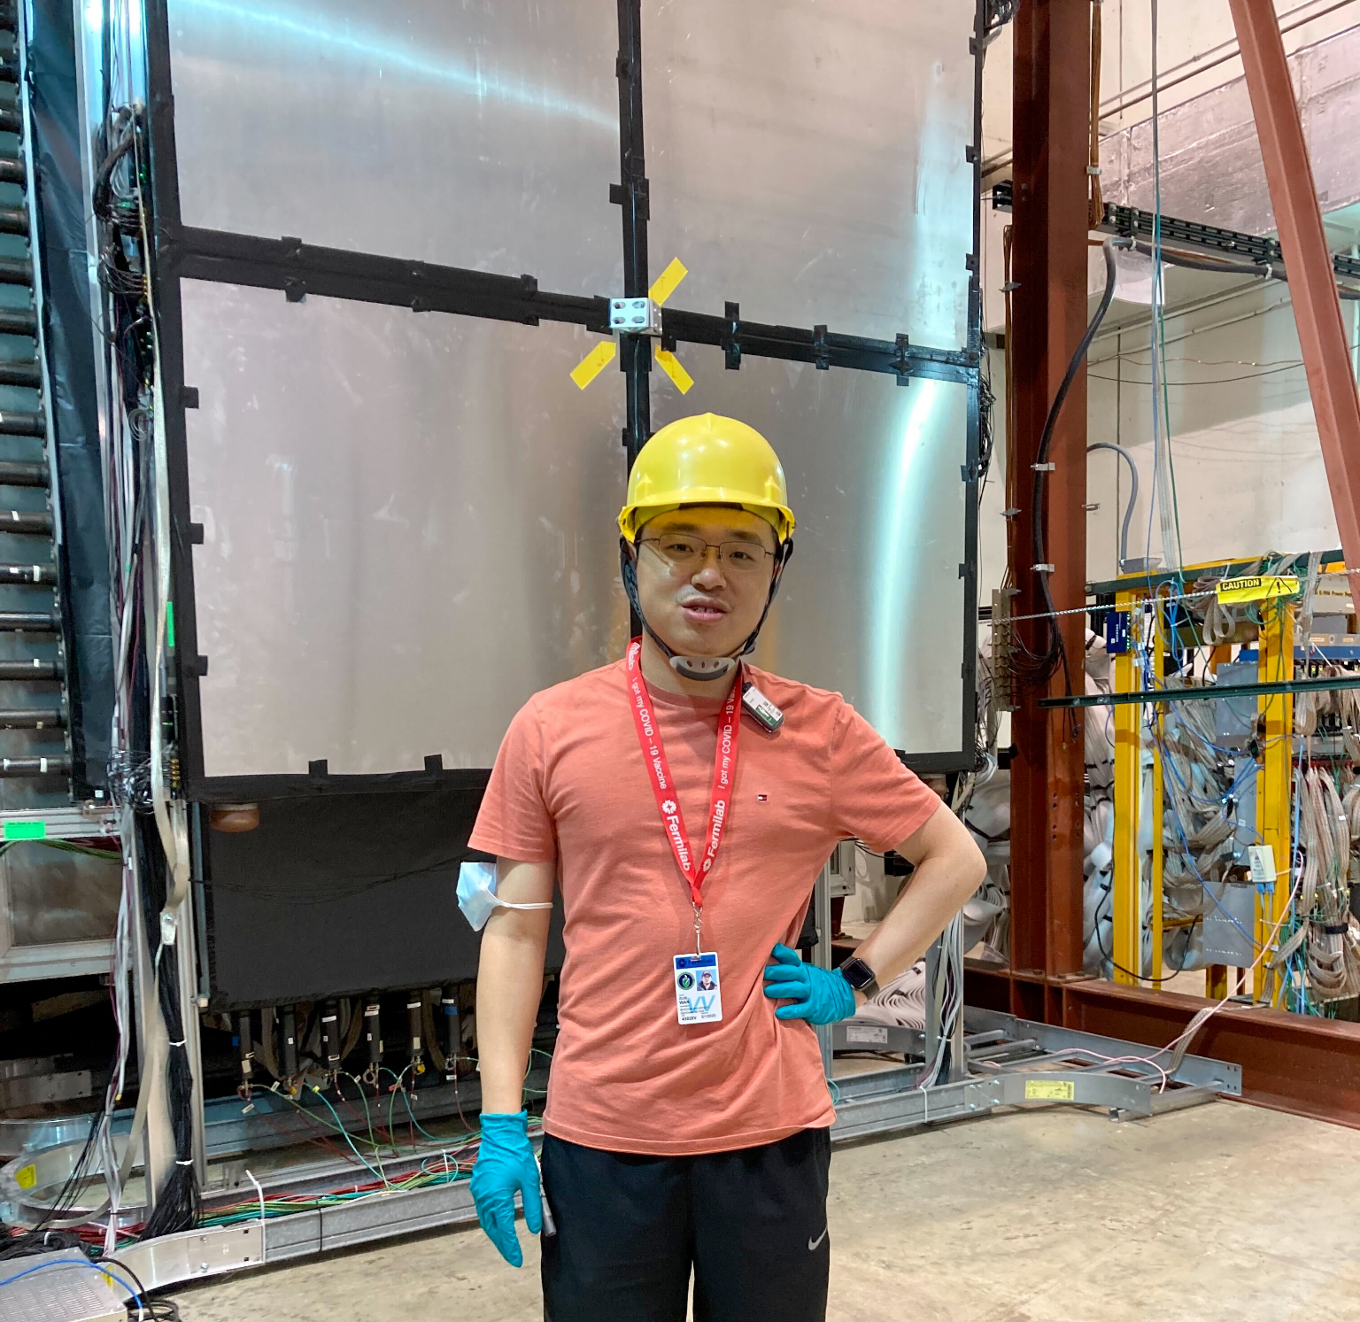
Dark Sectors @ SpinQuest/DarkQuest
Detailed study from HEP community to understand dark sector performance
Trigger
Tracking & Vertexing efficiency
Calorimeter & Particle ID
Mass reconstruction
A lot of progress in software and simulation:
trigger hodoscope studies; new displaced tracking algorithm with speed-ups (for prompt too) and simulation improvements for upgrade and dark sector event generation
Notes:
add pictures of zijie, cristina at NM4?

Slide 33
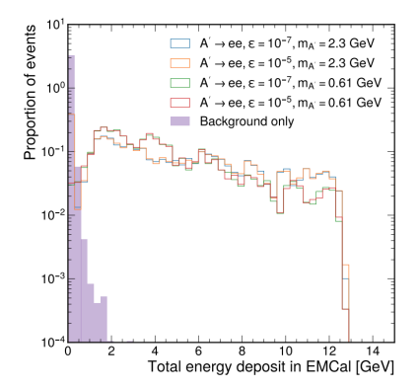
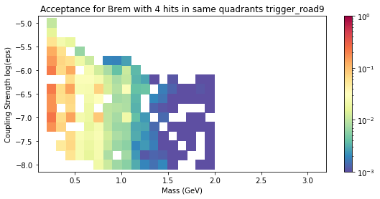
Dark Sectors @ SpinQuest/DarkQuest
Detailed study from HEP community to understand dark sector performance
Trigger
Tracking & Vertexing efficiency
Calorimeter & Particle ID
Mass reconstruction
EMCal Energy Trigger
Proposed Displaced Muon Trigger Efficiency
Notes:
Update to the single hit threshold, can we correct for the sampling fraction?
Update (Zijie! David!)

Slide 34
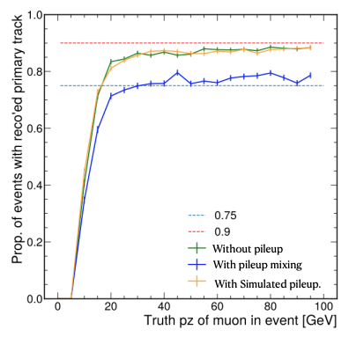
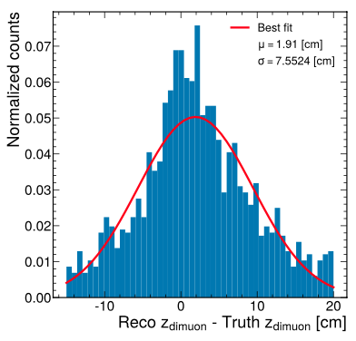
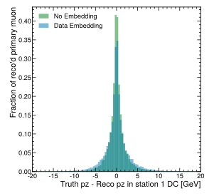
Dark Sectors @ SpinQuest/DarkQuest
Detailed study from HEP community to understand dark sector performance
Trigger
Tracking & Vertexing efficiency
Calorimeter & Particle ID
Mass reconstruction
vertex resolution
tracking efficiency
pz resolution

Slide 35
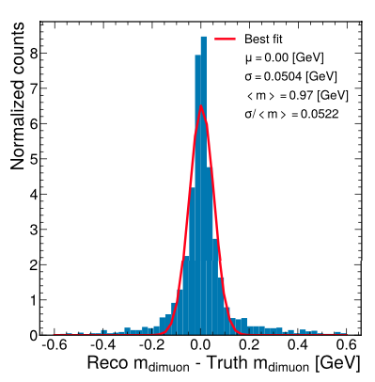
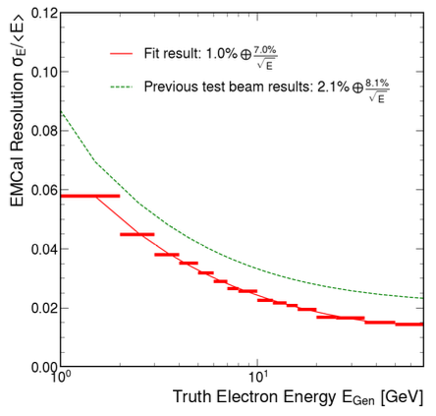
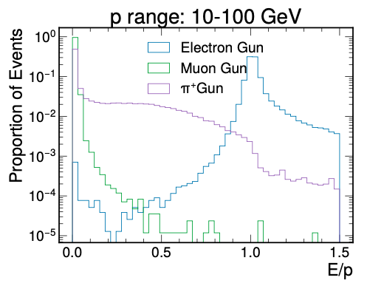
Dark Sectors @ SpinQuest/DarkQuest
mass resolution
Detailed study from HEP community to understand dark sector performance
Trigger
Tracking & Vertexing efficiency
Calorimeter & Particle ID
Mass reconstruction
Electron energy resolution
Particle ID
Notes:
Duc updates with this plot with mass resolution vs Mass

Slide 36
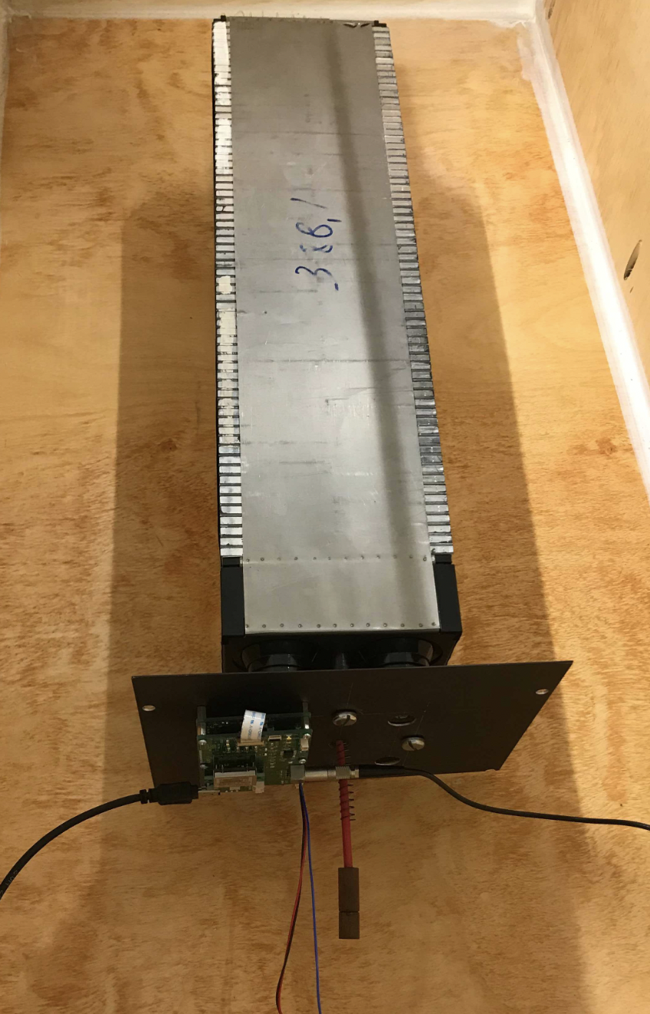
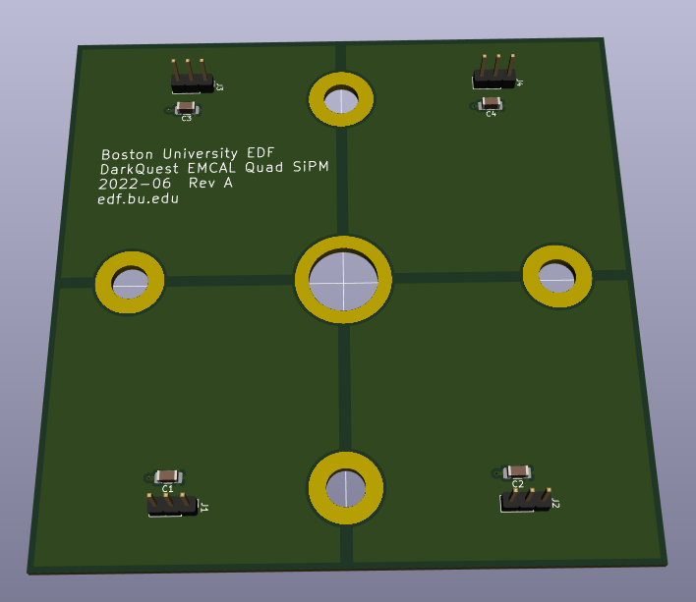
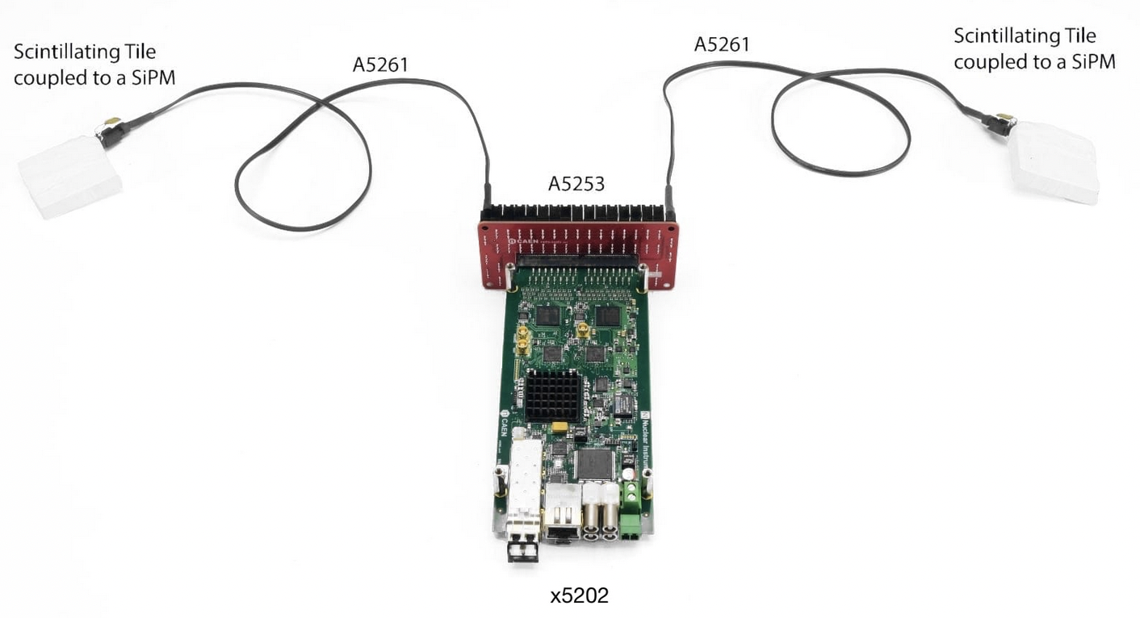
Dark Sectors @ SpinQuest/DarkQuest
EMCal Test Stand at BU
MIT/BU EMCal test stand has been developed for electronics studies
Comparing different readout options (fully custom and generic system a la STAR, or dedicated off-the-shelf system from CAEN)
CAEN FERS-5200 system a strong candidate: minimal design work, competitive price, and short lead time for integration
Will be available to measure background rates in NM4 later this year
Custom 4-ch SiPM Board
CAEN 64-ch A5202 ASIC Board

Slide 37
SpinQuest status and future nuclear/spin physics program
Notes:
See talk from Alexey too!

Slide 38
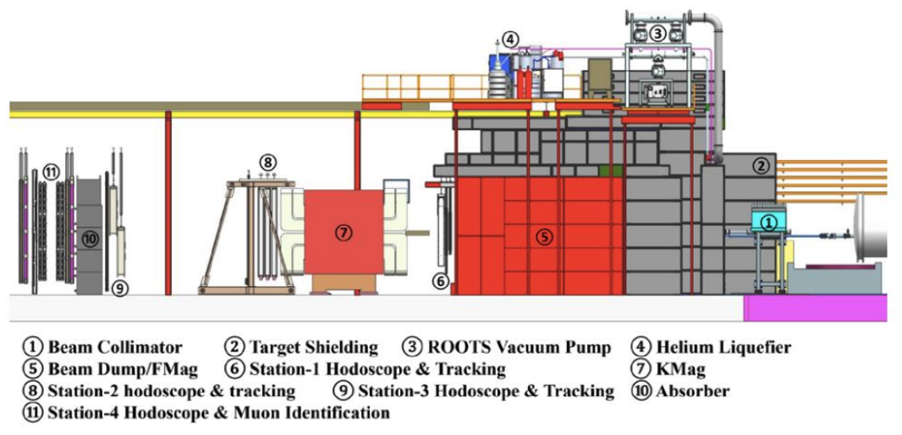
SpinQuest: construction and commissioning status
SpinQuest:
items #1-4
Inherited from SeaQuest: items #5-11

Slide 39
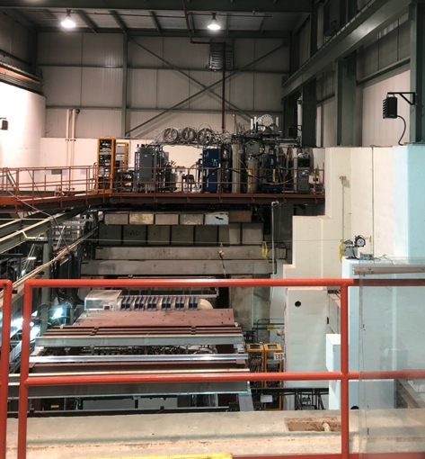
SpinQuest: construction and commissioning status
Construction of all aspects of SpinQuest nearly complete
New collimator installed
All cryo infrastructure piping installed
Cryogenic Safety Review now 98% complete (just a couple more weeks)
Pandemic and availability of lab resources cause of delays in completing these milestones
Target System Status
Liquefaction plant installed, commissioning going well (LHe storage dewars now full and ready).
Target electronics and infrastructure ready to use
Software/monitors/subsystems all ready
Now under Accelerator Readiness Review
New He Liquification Plant
Analysis Magnet
6/1/2022
Notes:
Prepared for commissioning of spectrometer with beam in late spring
challenges in getting FNAL resources for radiation review delayed beam past summer shutdown

Slide 40
SpinQuest: Moving Forward
SpinQuest next few steps for target system
Get Greenlight from Safety to run all parts
Test main transfer line (with LHe)
Have SC magnet cooldown (in July)
Start full cryogenic circulation commissioning
Polarize Target Material
Complete Cave Roof (shielding blocks)
Complete Accelerator Readiness Review
FNAL management has stepped in to ensure that this review takes place quickly and that SpinQuest has no further delays
Take beam in November
Detector is ready for beam commissioning
Online monitoring is ready
Analysis framework is ready
New He Liquification Plant
Analysis Magnet
6/1/2022

Slide 41
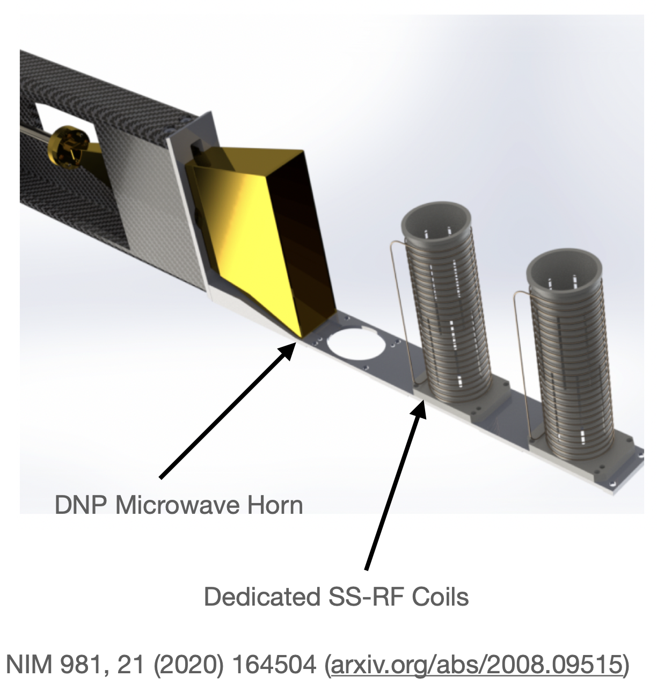
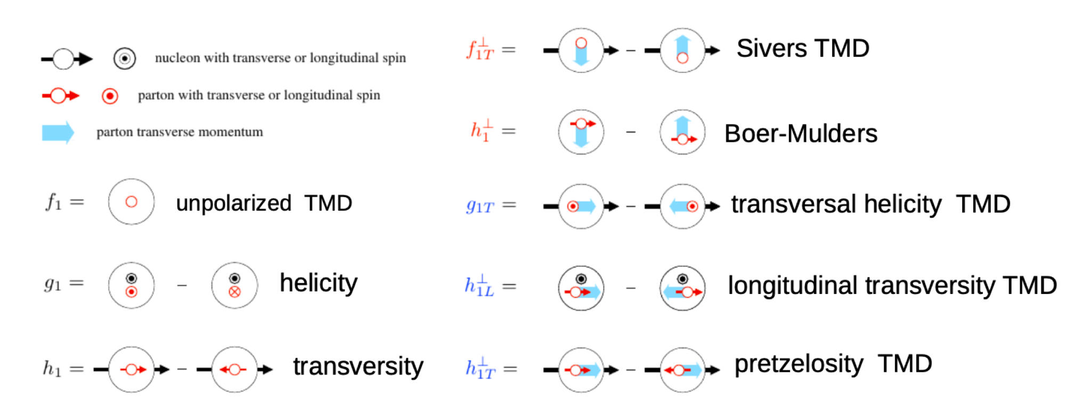
SpinQuest upgrade - future transversity program
Modest upgrade brings expanded nucleon transversity physics program Beyond non-zero Sivers/OAM, see more at Tranversity 2022 conference
Primary focus is Gluon Transversity – this would be the first experiment of its kind on a very hot topic in Spin Physics
}
Notes:
Noah W can help

Slide 42
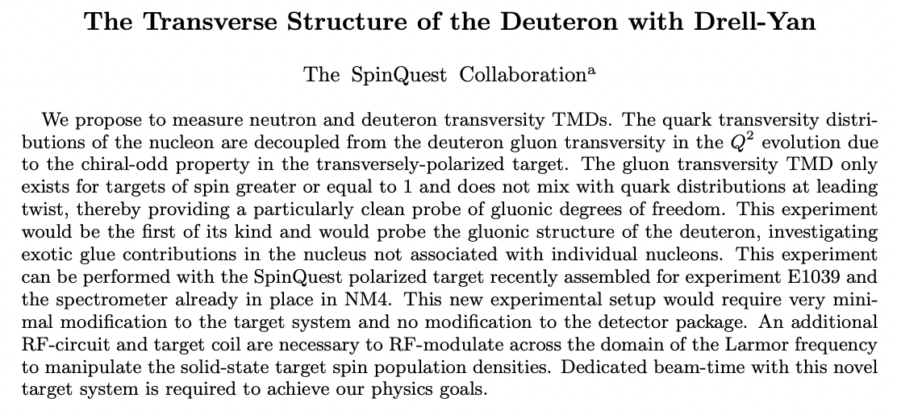
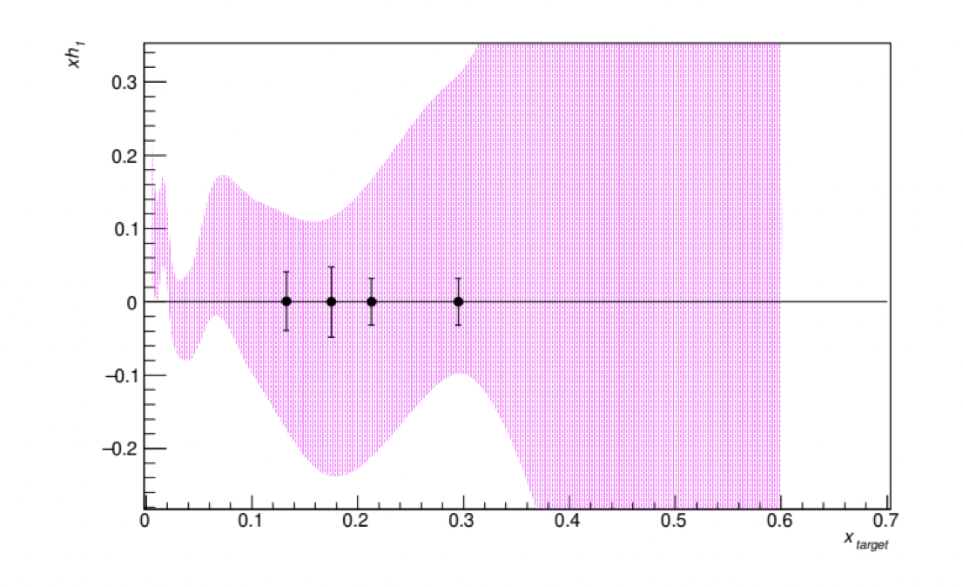
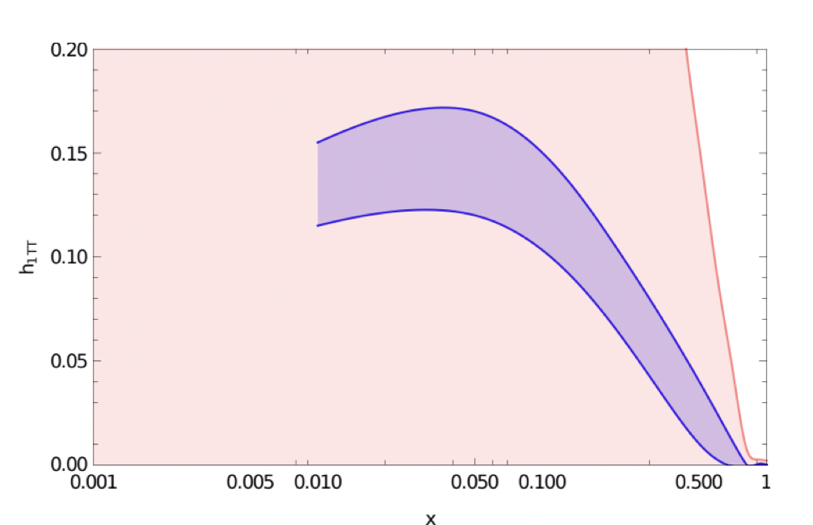

SpinQuest upgrade - future transversity program
Spin/NP upgrade program
Modest upgrade brings expanded transversity physics program Beyond non-zero Sivers/OAM, see more at Tranversity 2022 conference
SeaQuark Transversity
Gluon Tensor
Transverse Asymmetry
Gluon Transversity
arXiv:2205.01249
Very high proton luminosity from Main Injector
Large kinematic coverage overlaps with JLab and future EIC
Beam cycle allows target RF manipulations between spills
No other facility can offer these two combinations allowing access to these sought after observables
Notes:
Noah W can help

Slide 43
Collaboration and Outlook
Notes:
See talk from Alexey too!

Slide 44
Community and Collaboration
More collaboration between dark sector and NP members started > 1 year ago BU now a formal member, MIT associate members Build new Dark Sectors working group within SpinQuest
Bringing mutually beneficial technical collaboration – e.g. shared generation of large data samples, improvements to displaced and prompt tracking
Work on-going to understand technical aspects of running concurrently
Modest trigger bandwidth (~100 Hz) for displaced and e/γ final states Dedicated dark sector trigger menu with full bandwidth during target annealing
Notes:
(10% of 4 kHz) ??

Slide 45
Community and Collaboration
A lot of interest in the dark sector program! additional university HEP groups contributing students
Vibrant theory - experiment collaboration, large role in Snowmass Theory students working closely with experimenters
Modest seed efforts have brought concept significantly forward FNAL LDRD for exploring accelerator-based dark sector concepts (spread over 4 ideas) URA visiting scholar award, NSF graduate fellowship University startups to support students and hardware tests
… looking for support from PAC to expand our efforts!

Slide 46
High level vision – SpinQuest and DarkQuest
A vibrant and powerful spin and dark sector program running together
SpinQuest Phase
proton spin puzzle - measure Sivers asymmetry
dark sectors in muon final states: cover g-2 phase space, displaced dimuon
DarkQuest Phase
Modest upgrade, ~order of magnitude less cost than contemporaries EMCal upgrade (no degradation of spin physics), enhanced tracking and targetry
World leading physics Unique spin physics transversity program complementing EIC significant increase in dark photon sensitivity, opens signatures for iDM, ALP, SIMPs, etc.
High impact HEP and NP/spin physics; leverage DOE and Fermilab capabilities; short timeline with modest resources

Slide 47
Extra material

Slide 48

SeaQuest

Slide 49

Setting the stage: dark sectors at accelerators
RF6 report (to appear)
Snowmass message from dark sector searches at accelerators (RF6):
Modest upgrades enable near-term transformative dark sector physics
Notes:
Can we move Strong CP to red (non-thermal)
Fix Relaxion (spelled wrong)
Mention BRN - Thrust 2 is perfect fit for DarkQuest

Slide 50

Lanfranchi

Slide 51

Lanfranchi

Slide 52

Dark Sector Snowmass effort
Detailed study from HEP community to understand dark sector performance
Trigger
Tracking & Vertexing efficiency
Calorimeter & Particle ID
Mass reconstruction
Current Muon Trigger Efficiency
for displaced signatures
Notes:
Update to the single hit threshold, can we correct for the sampling fraction?
Update (Zijie! David!)

Slide 53


Slide 54

SpinQuest: construction and commissioning status

